Slide 1
Introduction to Supervision

Slide 2
Disclaimer
This presentation is prepared for the sole use of British Columbia Wildfire Service personnel and authorized standing offer contract holders. It may not be used by other agencies or individuals as a development guideline without the express written permission and cooperation of the British Columbia Ministry of Forests, Lands and Natural Resource Operations and Rural Development.

Slide 3
Course Outline
3 to 4 hour course.
Designed for contract crew leaders, fire wardens and industry foremen.
Recognized by the BCWS.
This course expands on the Incident Command System (ICS).
Evaluation Criteria:
- there is a Written Exam.
- you need 70 % on the exam to pass.

Slide 4
Learning Objectives
Why we use the ICS and where the Crew Leader fits.
What a Crew Leader needs to know.
Why we need to maintain good communications with all supervisors.
Setting a good example for the crew.
Maintaining the safety and welfare of your crew members.
Techniques for motivating a crew.
How to maintain crew discipline.

Slide 5
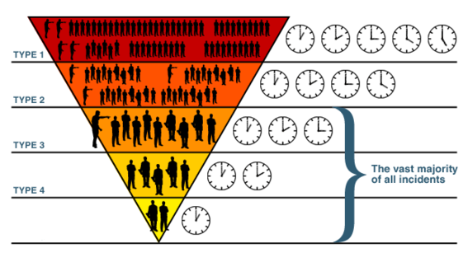
Course Overview
The S-230 was developed in the United States.
BCWS standards have been incorporated into the course - LACES.
The ICS structure is emphasized.
Basic crew leader knowledge and skills are reviewed.

Slide 6
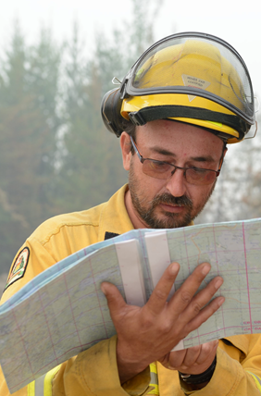
Purpose of this Course
Suppression Planning
Explains the crew leader’s position in the ICS.
Describes roles and functions of a crew leader.
Provides an awareness of crew motivation and discipline issues.
Helps make confident and effective leaders.

Slide 7
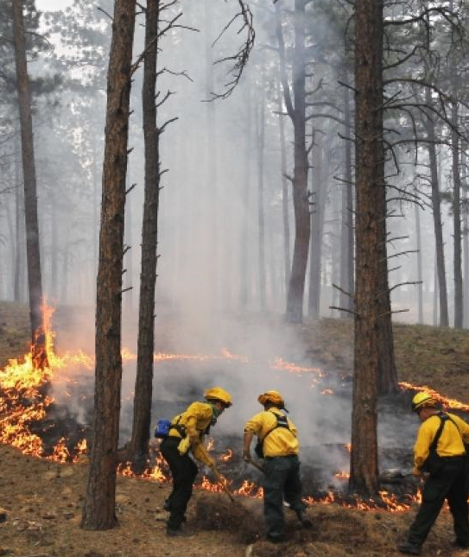
The ICS Basics
Every incident needs to be managed well.
The ICS is used for all BC wildfires.
Even small fires integrate this structure.
The system is split into 5 main functions.
IA
Target

Slide 8
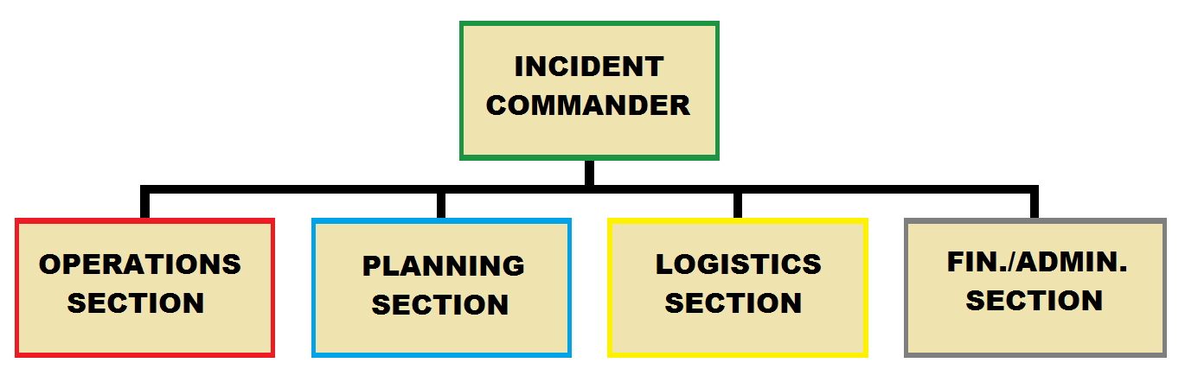
The 5 ICS Functions

Slide 9
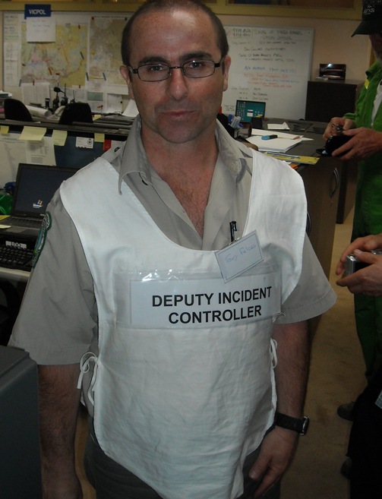
The Command Staff
Set objectives and priorities for a wildfire.
The Incident Commander (IC) - has overall responsibility.
The general staff report to the IC.
May include Safety, Information and Liaison Officers.

Slide 10
The General Staff
Operations Section Chief: responsible for tactical fire suppression assignments.
Planning Section Chief: responsible for collecting data to make Incident Action Plans.
Logistics Section Chief: responsible for support and services at an incident.
Finance and Administration Section Chief: responsible for cost analysis, claims and time keeping.
The functions are colour coded for ease of breakdown.

Slide 11
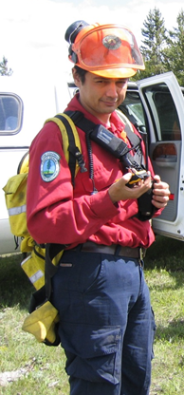
The Crew Leader
Can have numerous roles on a wildfire.
Function will be determined by the size of the incident.
Could be the IC on small wildfires.
Will report to the IC or Crew/Division Supervisor on large wildfires.

Slide 12
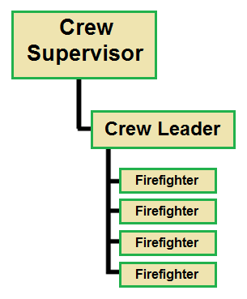
The Chain of Command
Firefighters have ‘One Boss and only One Boss.’
Firefighters will only be directed by 1 immediate supervisor.
This rule is respected at all times.
Supervisors need to know the location of all subordinates at all times.

Slide 13
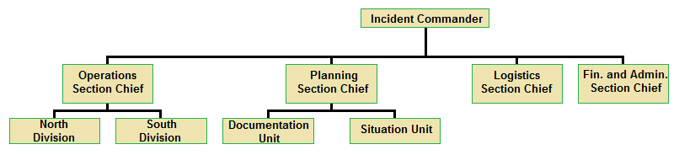
Span of Control
Supervisors should only be responsible for a maximum of 7 workers.
The optimum span of control is 1 supervisor to 5 subordinates.

Slide 14
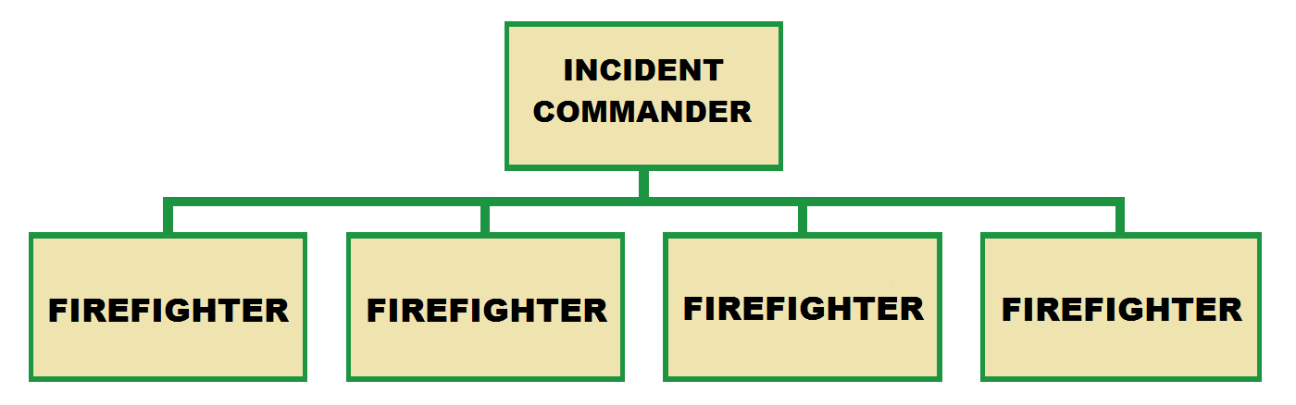
Small Fires - Type 4 or 5

Slide 15
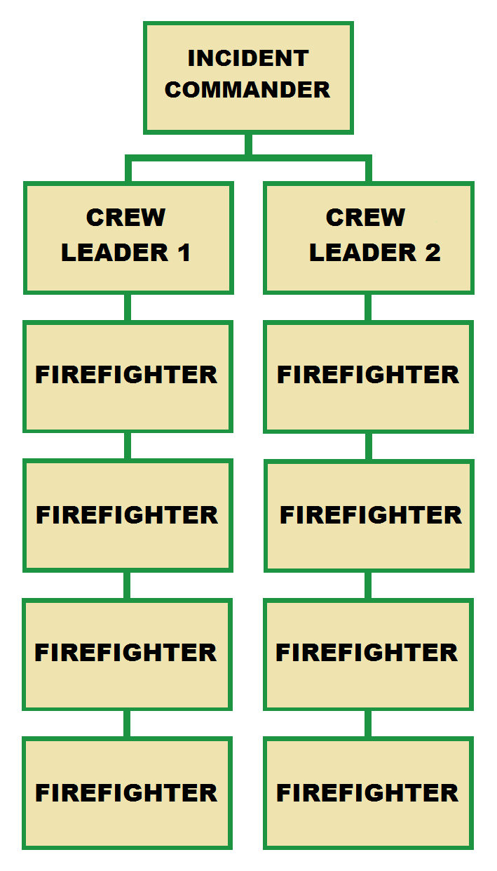
Small to Moderate Fires - Type 3 or 4

Slide 16
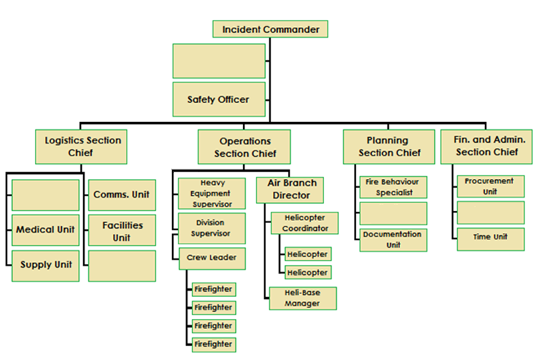
Moderate to Large Fires - Type 2 or 3

Slide 17
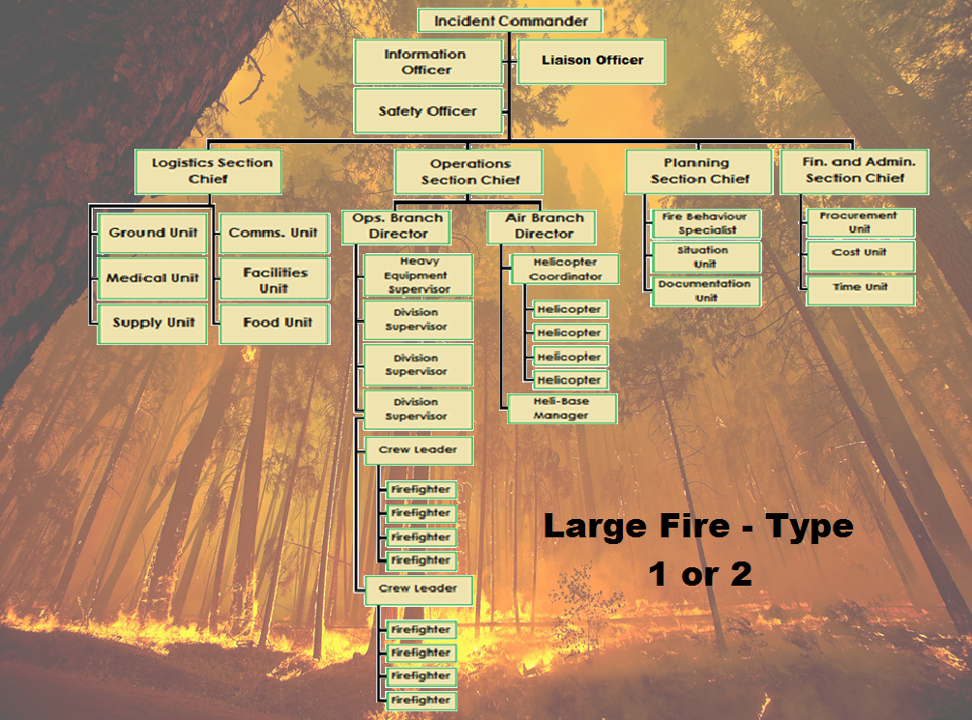

Slide 18
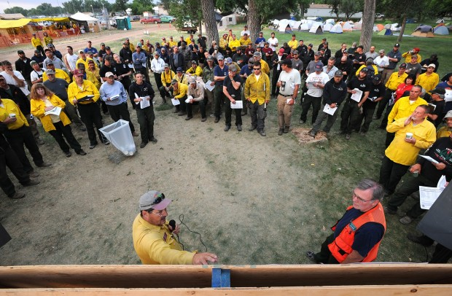
ICS General Staff Breakdown
More resources are added when an ICS function is activated.
Experienced personnel will take leadership roles.
Chain of command will be followed.
Allows span of control to be in an optimal state.

Slide 19
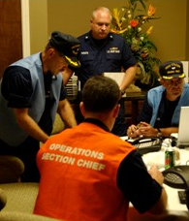
The Operations Section
Manages the tactical operations.
Promotes fireline safety.
All fire personnel work together on suppression activities.
Helps with Incident Action Plan (IAP) tasks.
Gives progress updates to the IC.

Slide 20
Operations Section Framework
Operations Section Chief
  Branch Directors
    Division/Group Supervisors
      Task Force/Strike Team
      Leader/Crew Supervisor
          Single Resource Leader
        Crew Leader

Slide 21
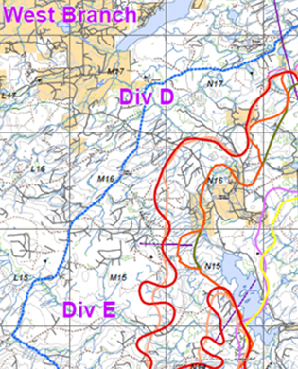
Operations Section - Branches
Divided into geographic locations or functions.
Report to the Ops. Section Chief.
Air Operations Branch Director:
- Air Tactical Group Supervisor.
- Air Support Group Supervisor.

Slide 22
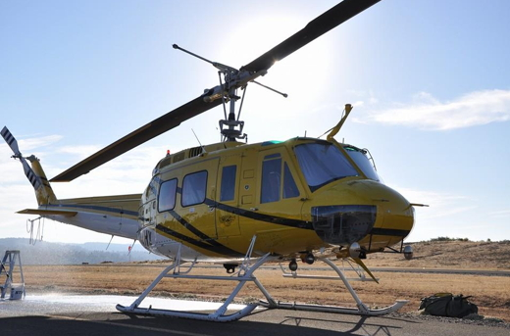
Air Operations Branch
Air Tactical Group Supervisor
- Helicopter Coordinator
- Air Attack Officer
Air Support Group Supervisor
- Heli-base Manager
- Loadmaster
- Helicopter Time Keeper

Slide 23
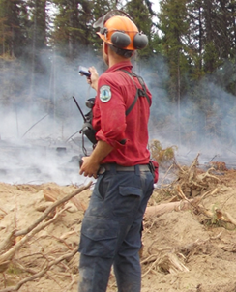
Role of the Crew Leader
Crew leaders will be in the operations section on large fires.
Crew leaders direct wildfire crews.
Responsible for fire suppression progress.
Will ensure crew safety while on the fireline.
Fire
Photos

Slide 24
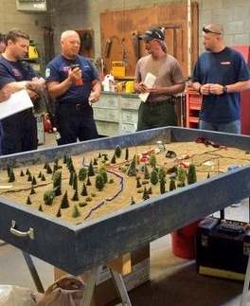
The Planning Section
Collects, evaluates, processes and distributes incident information.
Works with the Operations Section.
Develops the IAP for fire personnel.
Tasks are divided into Units.

Slide 25
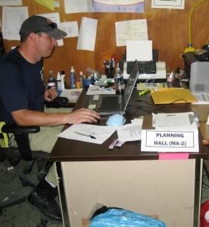
Planning Section Framework
Planning Section Chief
  Resource Unit
  Situation Unit
  Documentation Unit
  Demobilization Unit

Slide 26
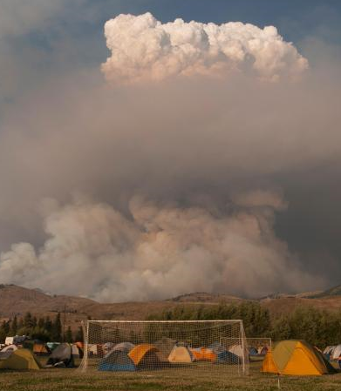
The Logistics Section
Provides support and services to all fire personnel.
Determines best camp facilities for wildfire event.
Establishes first aid coverage on large incidents.
Coordinates meals for crews.
Base
Camp

Slide 27
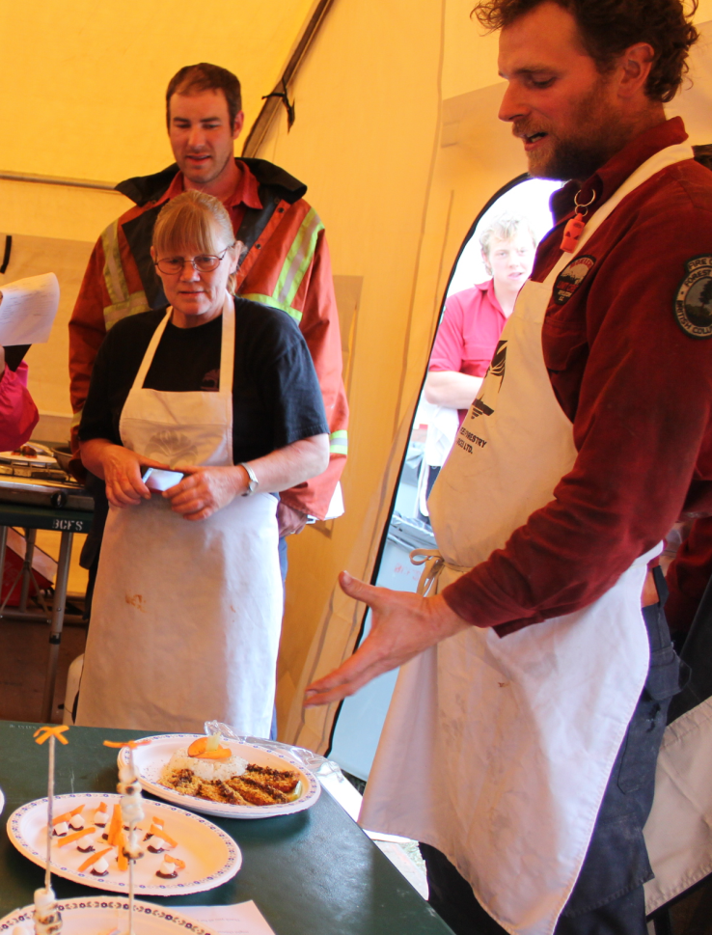
Logistics Section Framework
Logistics Section Chief
  Supply Unit
  Facilities Unit
  Ground Support Unit
  Communications Unit
  Food Unit
  Medical Unit

Slide 28

The Finance and Administration Section
Responsible for keeping all time records - daily hours.
Completes cost analysis for wildfires.
Helps with employee injury compensation paperwork.
Examines property damage claims.

Slide 29
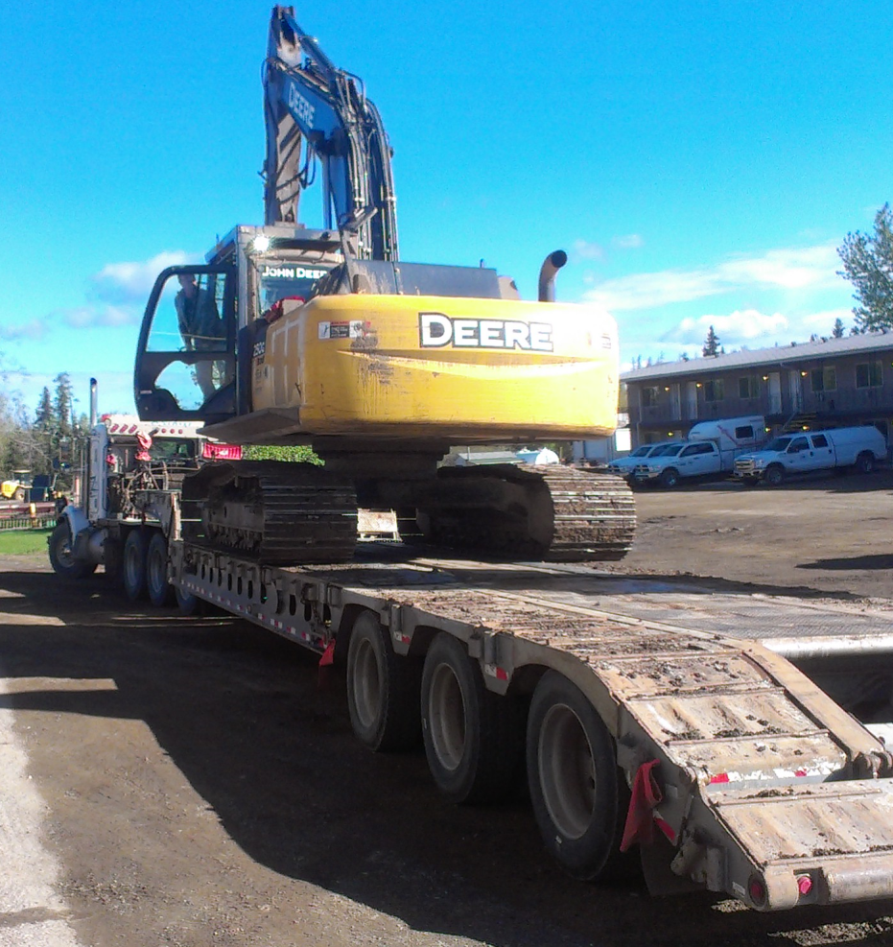
Finance and Administration Section Framework
Finance and Administration Section Chief
  Time Unit
  Procurement Unit
  Compensation and Claims Unit
  Cost Unit
Procuring Equipment

Slide 30
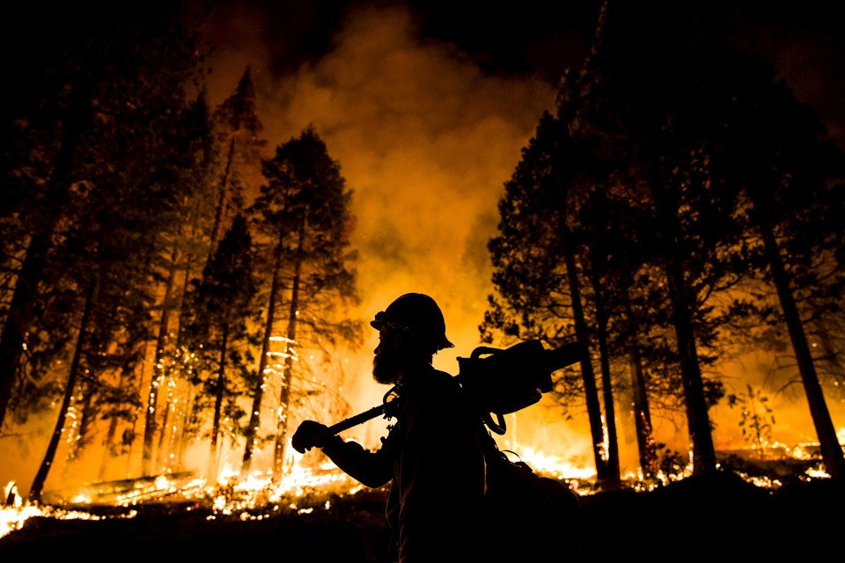
Questions?

Slide 31
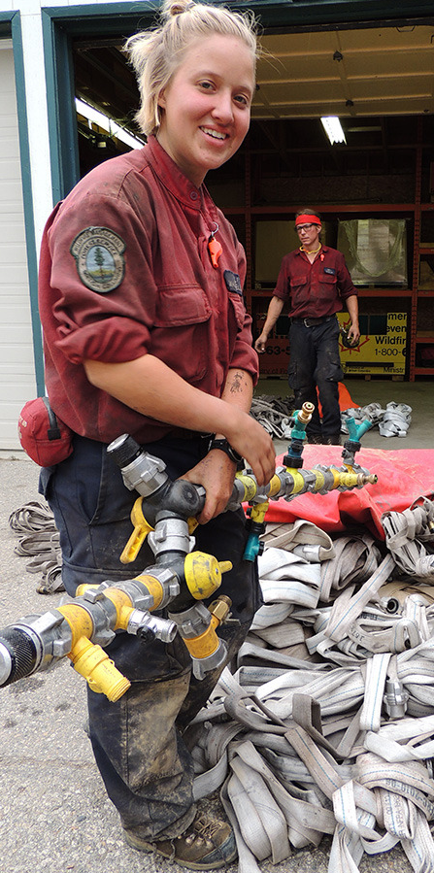
Qualities a Crew Leader Needs to Develop
Crew Leaders rely on the following qualities:
Using Common Sense.
Being Alert - Situational Awareness.
Thinking Critically.
Acting Decisively.
Never Making Assumption.
Being Understanding.

Slide 32
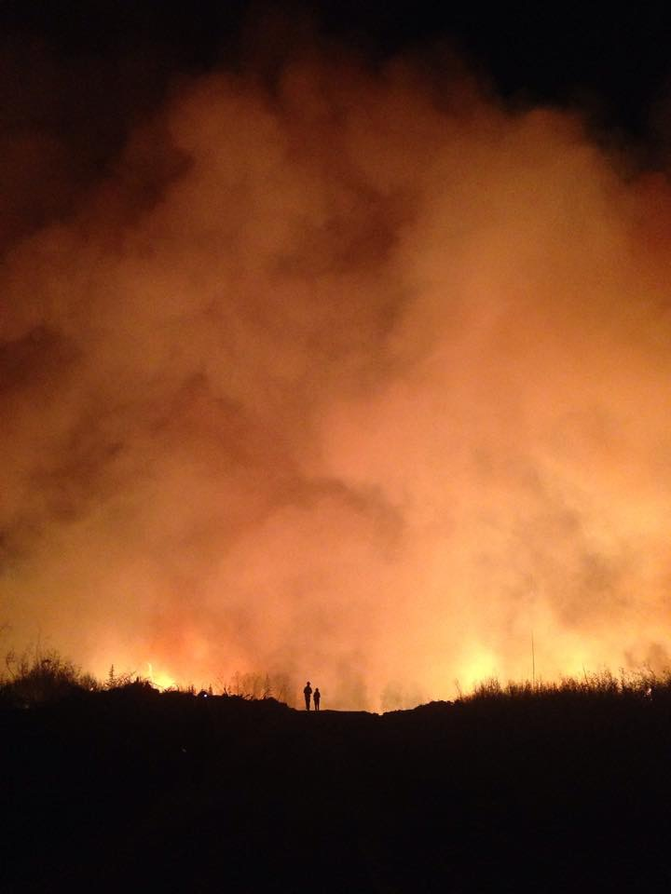
Knowledge and Skills of the Crew Leader
Crew Leaders need to have an understanding of the following:
Fire behaviour and assessment.
The 3 fire suppression attack methods - burning operations.
Mop-up and patrol activities.
Fire equipment and machinery used.

Slide 33
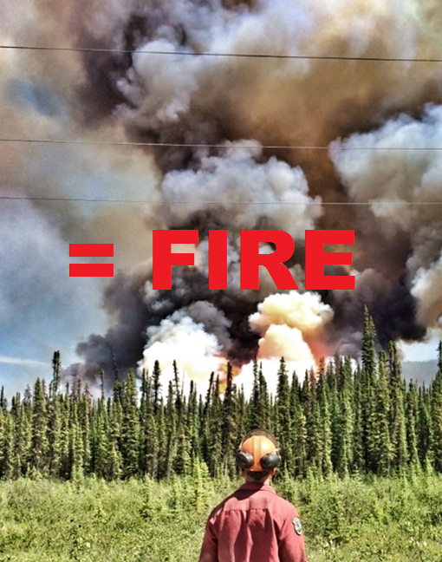
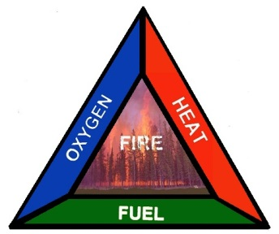
Review: The Fire Triangle
Oxygen - in the air
Heat - from lightning or people
Fuel - forest vegetation
Removing 1 or more elements results in fire suppression.

Slide 34
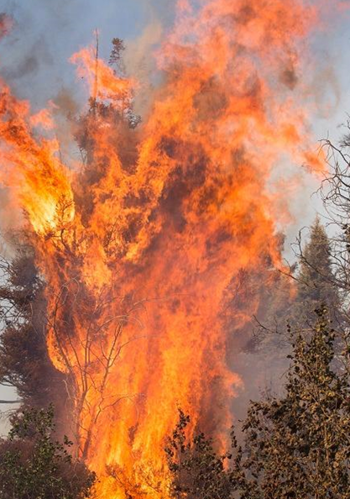
Review: Factors Influencing Fire Behaviour
The 3 main factors that influence fire behavior are:
Fuel - moisture level is the most critical.
Weather - wind is the most significant variable for fire spread rates.
Topography - fires move rapidly upslope.

Slide 35

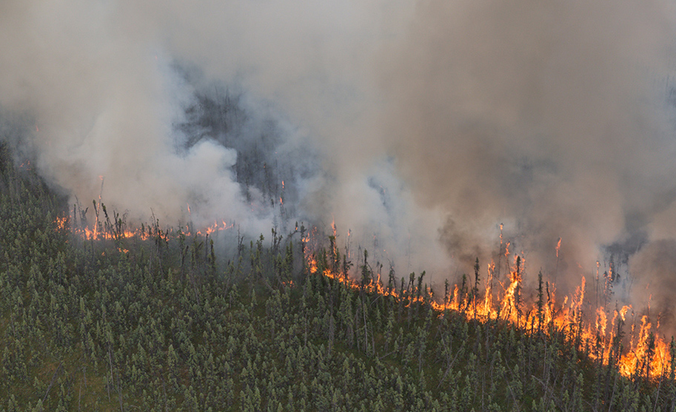
Fuel
The Black
Spruce

Slide 36
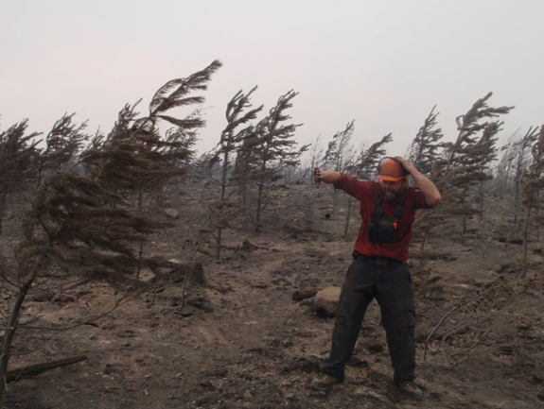
Weather
Wind or
Flash Freeze?

Slide 37
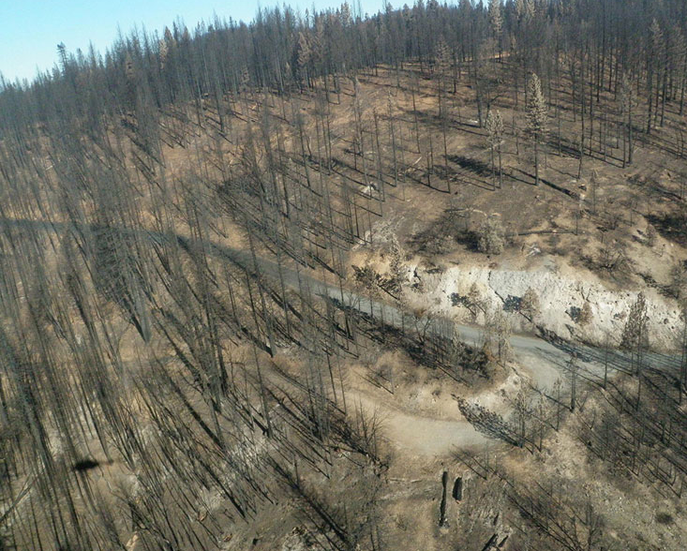
Topography
Moderate Slope

Slide 38
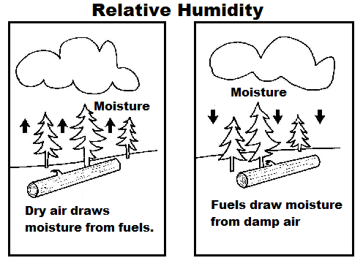
Review: Weather and Fire Behaviour
The 3 weather variables crew leaders need to be aware of are:
Wind - changes direction and increases rate of spread.
Relative Humidity - the amount of water vapour in
the air.
Temperature - dries out forest fuels.

Slide 39
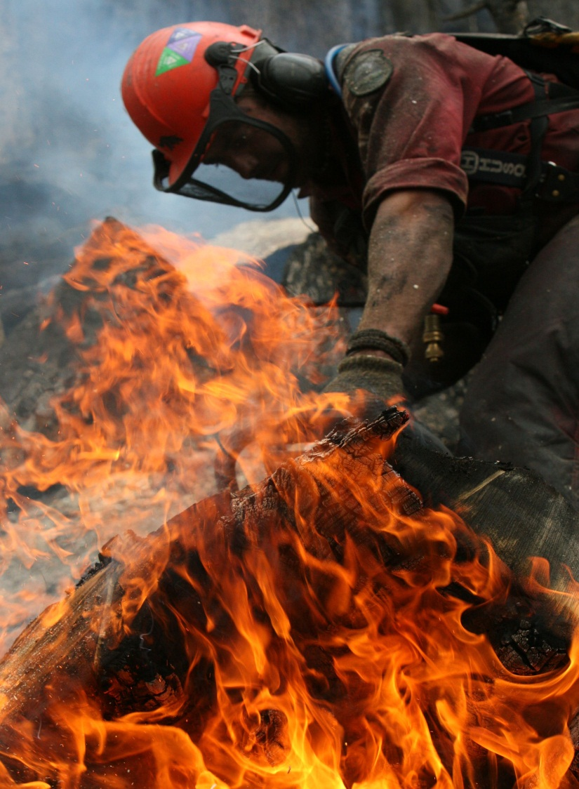
Review: Fire Attack Methods
The 3 attack methods used to suppress wildfires are:
Direct Attack - used on low intensity fires.
Parallel Attack - used on moderate intensity fires.
Indirect Attack - employed during high intensity fires.

Slide 40
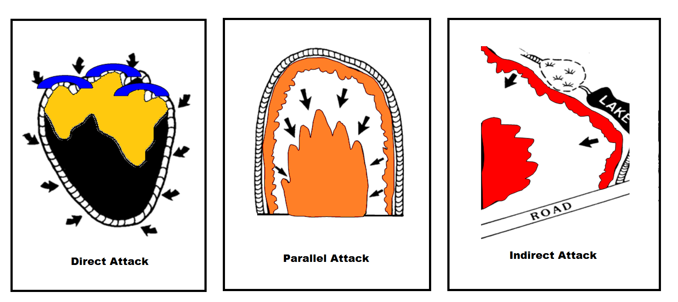
The 3 Attack Methods

Slide 41
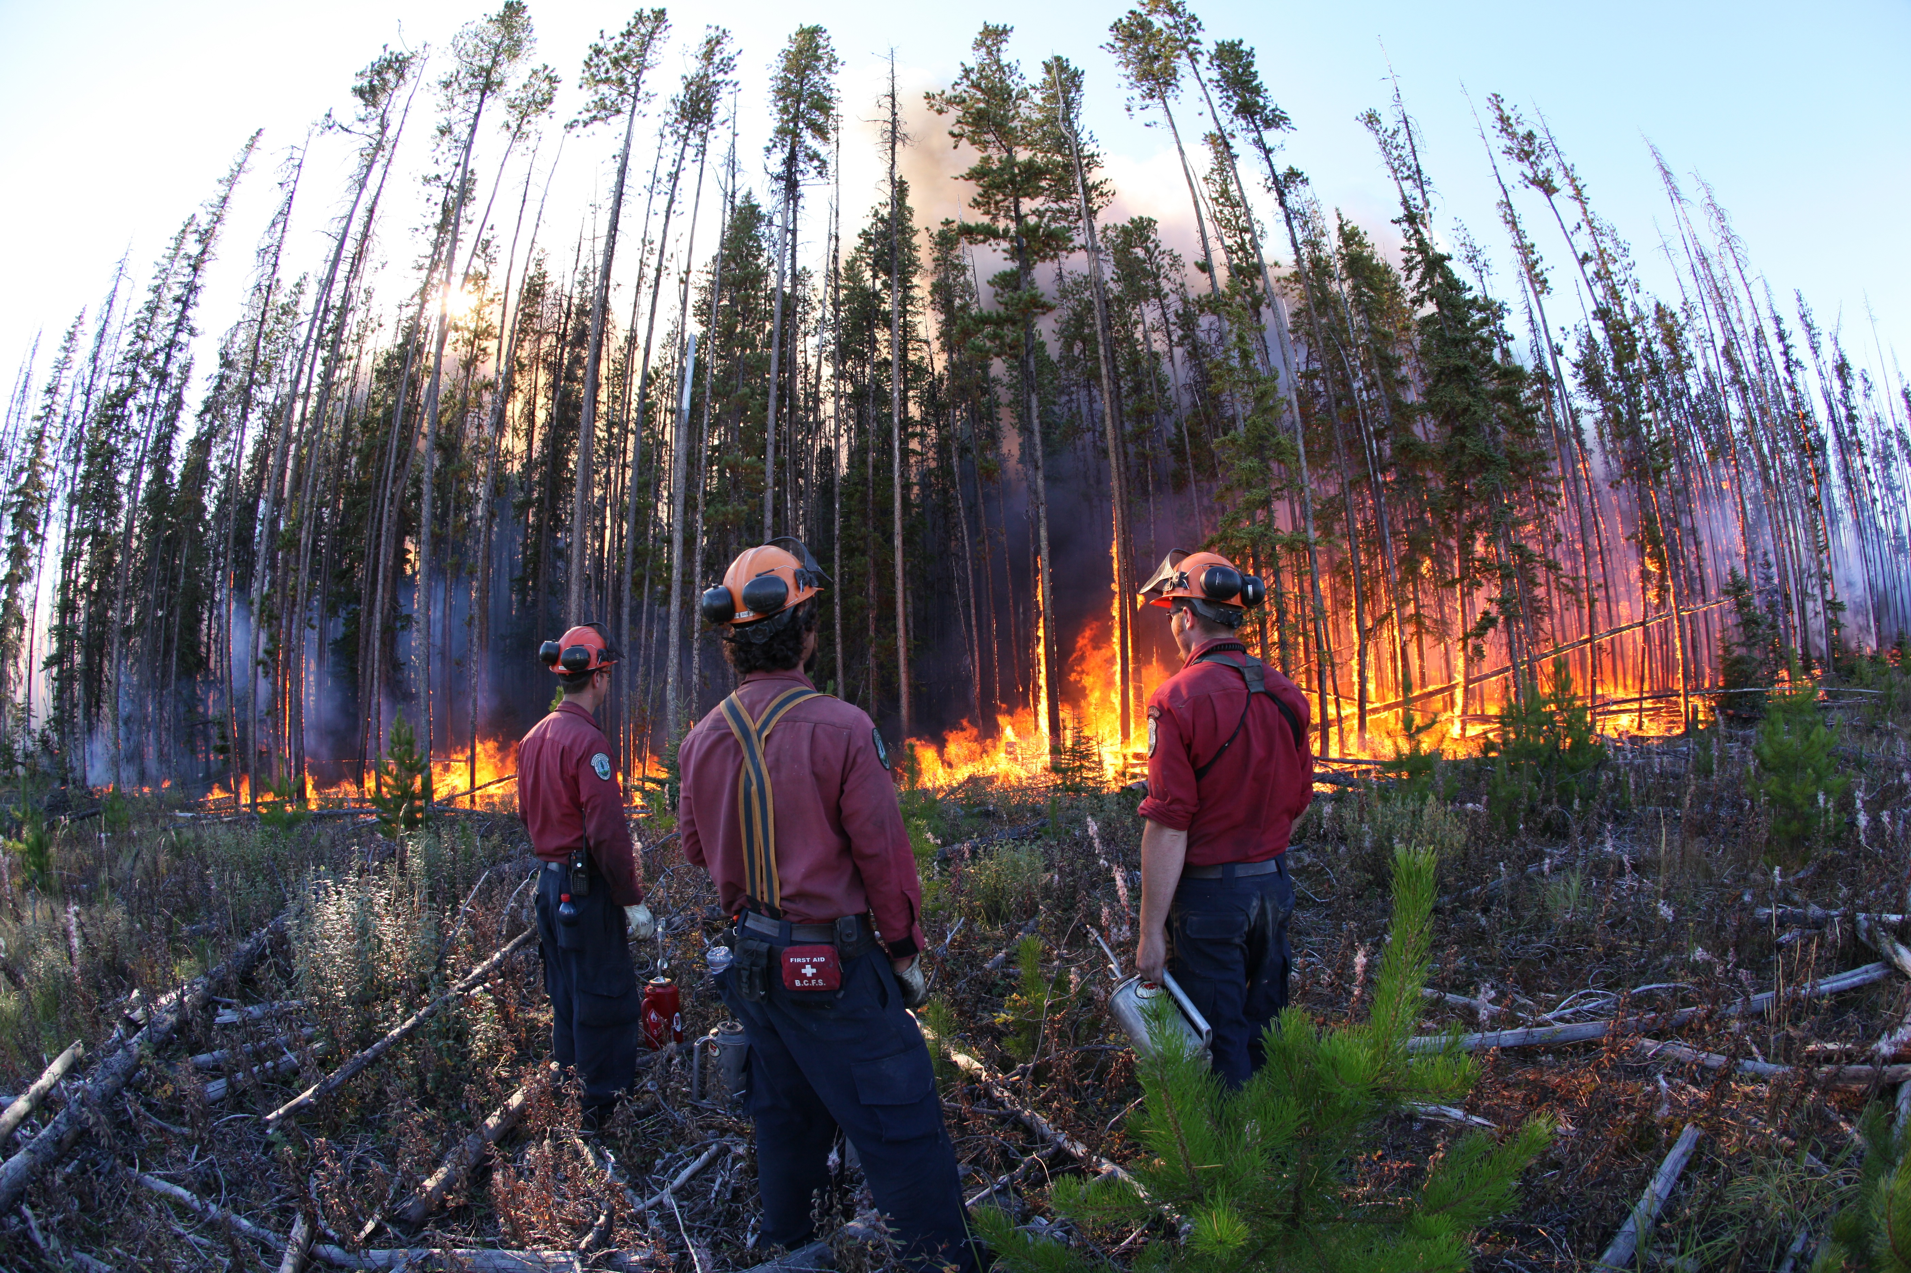
Review: Burn Operations
Unburnt fuels are ignited.
Burning helps widen control lines.
Prevents flare ups or hot spots from escaping.
Reduce the risk of fire entrapment by eliminating unburnt fuels.
Helps to maintain Anchor Points.

Slide 42
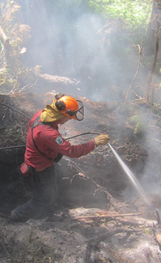
Review: Post Fire Containment Tasks
Mopping Up
The following activities are essential after a wildfire has been contained:
Mop-up of the fire perimeter.
Patrol of the wildfire.
Cold trailing of root systems.

Slide 43
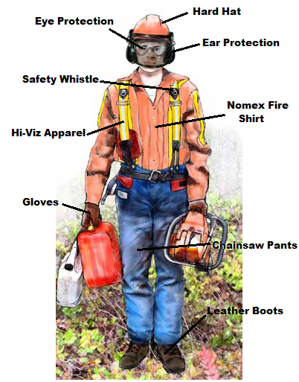
Crew Safety and Wellbeing
A crew leader’s first priority is crew safety.
All fire suppression activities should be complete in a safe manner - use PPE.
LACES will be used.
Crews need to use safe work practices while in transport and at camp.

Slide 44
Crew Leader Safety Briefing
Review the following:
LACES.
Location of first aid equipment.
Current fireline hazards.
Safe work procedures.
Current and predicted fire behaviour.
Fire suppression strategies and tactics.
Current suppression tasks and progress.
Crew work assignments.

Slide 45
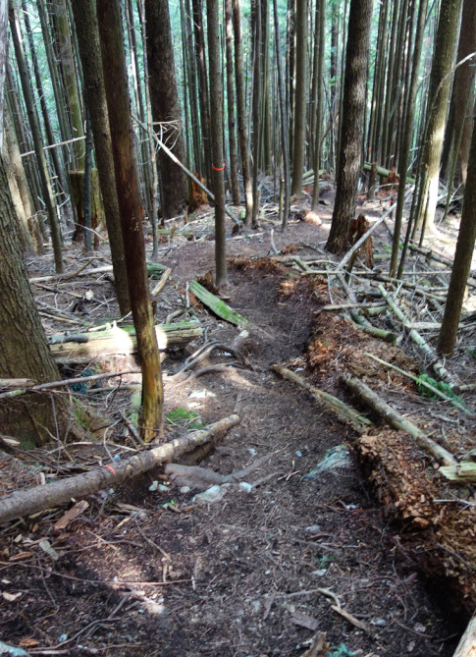
LACES
Is a safety system used to protect fire personnel.
Needs to be in place before suppression activities start.
Allows for assessments and updates on fire activity.
Establishes evacuation routes and refuge areas.
Maintained
Escape Route

Slide 46
LACES
Lookouts - personnel who assess the fire.
Anchor Points - fuel barriers free of vegetation that secure control lines.
Communications - radio transmissions between firefighters on the fireline.
Escape Routes - used to rapidly retreat from the fireline if fire behaviour increases.
Safety Zones - provide firefighters with shelter from all fire hazards.

Slide 47
General Expectations of a Crew Leader
Crew leaders must describe expectations to the crew.
An evaluation of individual abilities must be completed.
Crew leaders need to set an example - use safe work procedures.
Establish fire camp and base rules.
Explain the following fire camp procedures:
- Crew Meal Times.
- Sleeping Accommodations.
- First Aid and Wash Facilities.

Slide 48
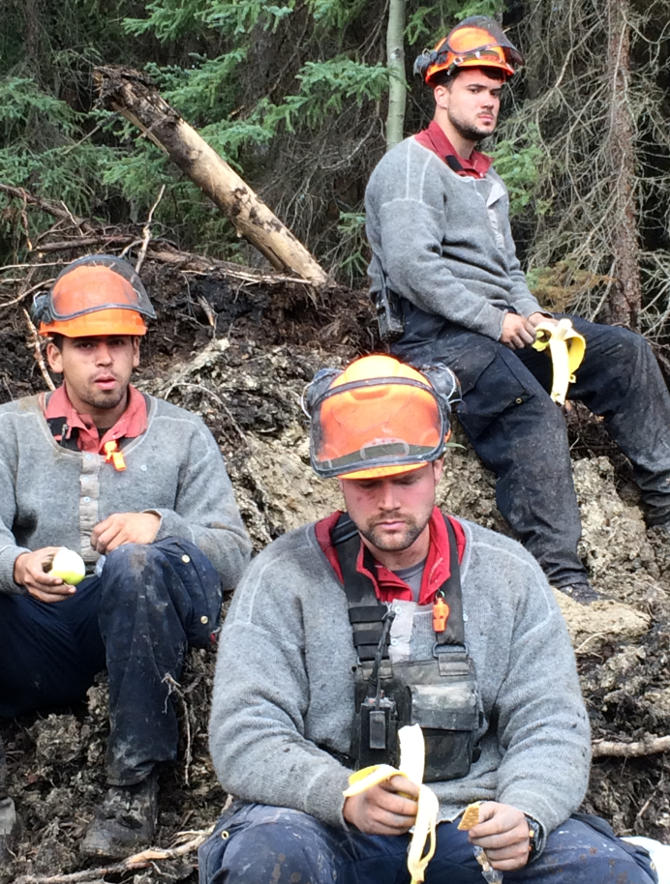
Maintaining Crew Standards
Crew leaders must demonstrate proper safe work procedures.
Emergency procedures need to be practiced - each crew member has a role.
Crew members need to be trained correctly.
Hazards must be communicated to all fire personnel.

Slide 49
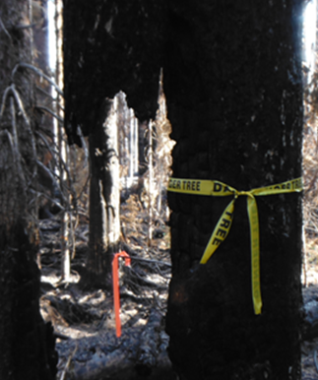
Safety Responsibilities
Crew leaders must ensure:
Crew member locations are know at all times.
Hazards are communicated.
All personnel know where the escape routes and safety zones are.
Injuries are reported.
Crew fatigue is managed.
Danger Tree!

Slide 50
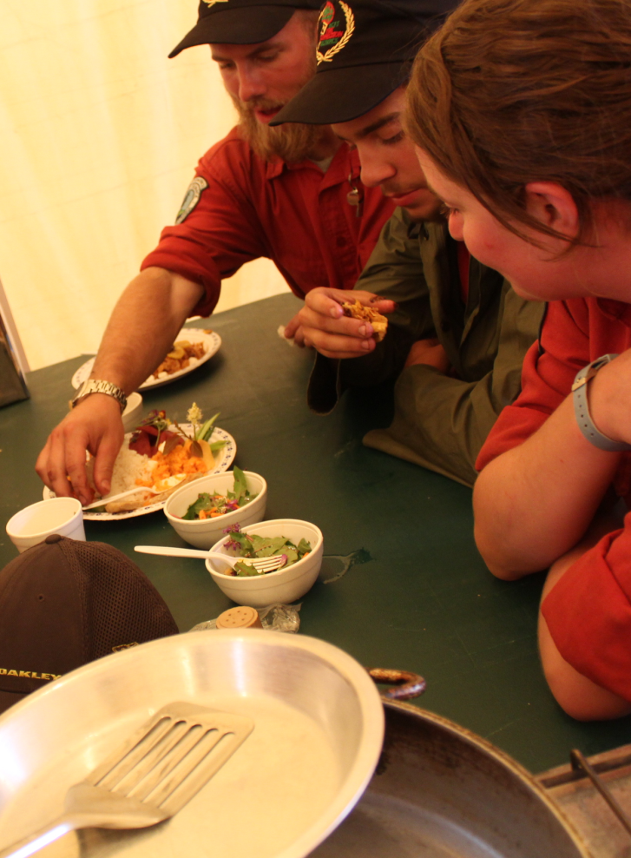
General Wellbeing Factors
Crew leaders are responsible for the following:
Ensuring that check-ins are established.
Checking condition of each crew member’s PPE.
Staying calm and positive.
Confirming that all crew members are supplied with meals.

Slide 51
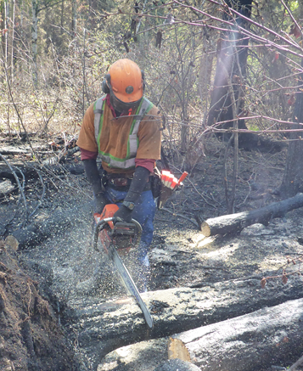
Crew Organization and Supervision
On the Fireline:
Train crew members as needed.
Closely track progress.
Organize crew to work most effectively.
Give experienced crew members important tasks.
Bucker Training

Slide 52
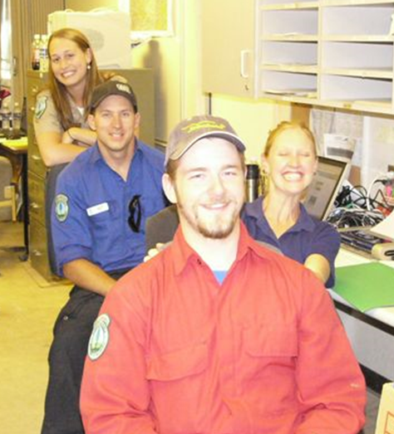
Administrative Responsibilities
A crew leader must accomplish the following:
Inspect the working being completed.
Maintain daily notes.
Update supervisors about crew progress.
Address concerns and setbacks.

Slide 53
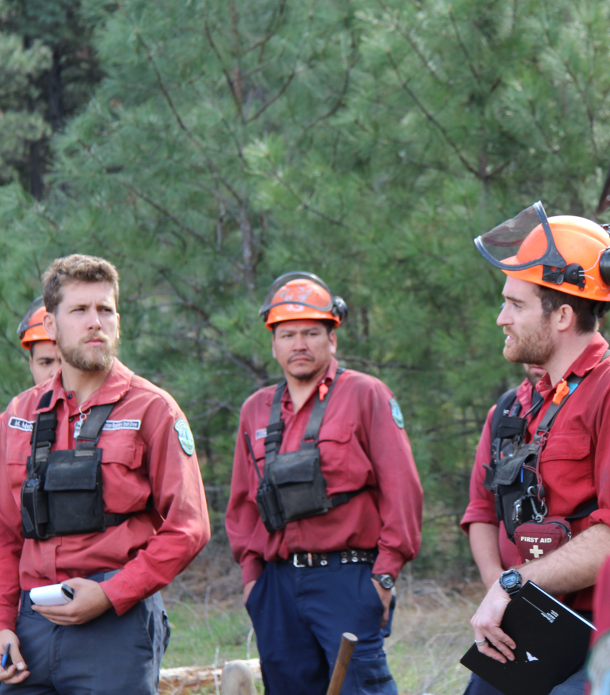
Crew Organization and Supervision
Off the Fireline:
Maintain a record of crew member names and functions.
Complete all crew paperwork.
Maintain all crew gear.
Brief the crew on daily plans and objectives.
Daily Crew Briefing

Slide 54
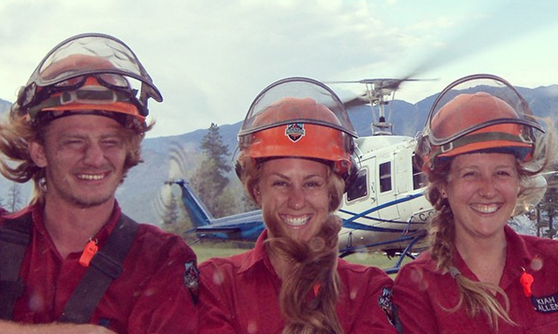
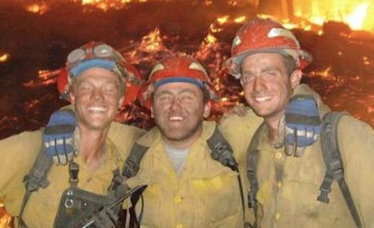
Motivating and Disciplining a Fire Crew
These are 2 difficult tasks for any crew leader.
Crew leaders need to build good rapport with a crew.
A crew must continuously be pushed to succeed.
Any corrective actions taken must be warranted and appropriate.

Slide 55
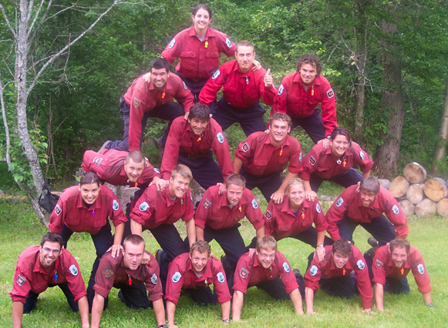
Tips for Motivating Fire Personnel
Communicate effectively.
Set realistic goals that can be accomplished.
Update the fire crew about achievements.
Give compliments and support when appropriate.
Perform fireline tasks with the crew.

Slide 56


Disciplining Fire
Personnel
A crew leader should:
Know how and when to discipline a crew member.
Know how to recognize a crew trouble maker.
Understand the types of discipline.
Use disciplinary measures in a consistent and fair manner.
Crew Leader
Trouble
Maker

Slide 57
Disciplinary Discussion
Instructions
Separate into groups of 3 or 4 trainees.
Select 3 crew member behaviours that may warrant disciplinary action.
Discuss how each member of the group would react to every situation.
Determine the best possible answer to each problem.
Share the most challenging scenario.

Slide 58
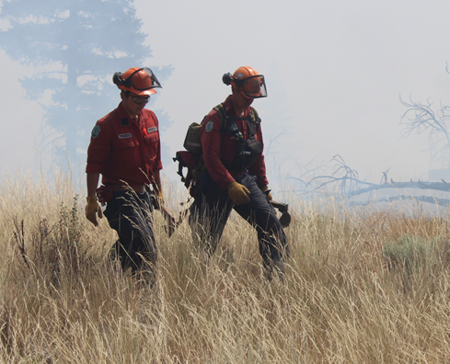
Instructor’s Experiences with Crew Discipline Issues
How I Discipline . . .

Slide 59
Basic Leadership Principles
Be loyal to your crew and your supervisors.
Set the best possible example.
Be approachable and flexible.
Think and make effective decisions.
Be reliable, honest and trustworthy.

Slide 60
Your Role as a New
Supervisor
Understand how the ICS is organized and where the your place is on wildfires.
Know the Chain of Command and Span of Control guidelines.
Have a working knowledge of fire behaviour and suppression methods.
Maintain fire crew safety at all times.
Establish positive relationships with your crew members.
Effectively motivate and discipline your fire crew.

Slide 61
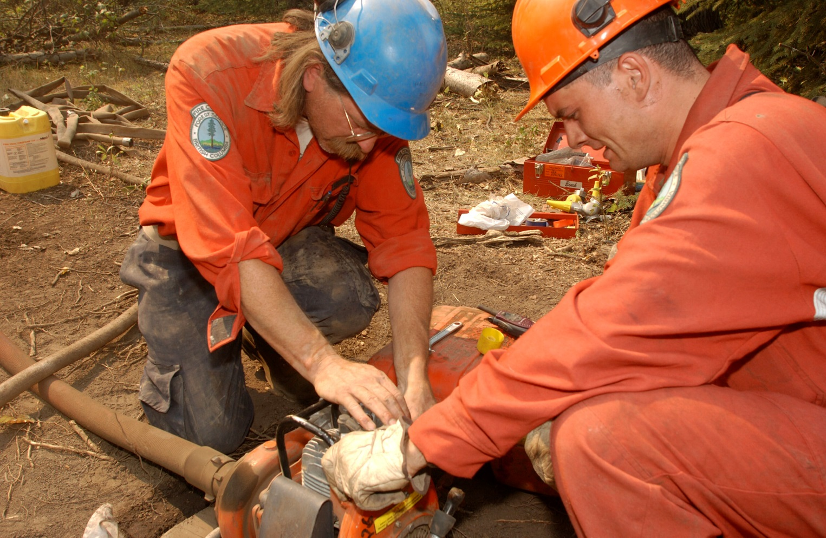
Questions?

